Slide 1


Stonks
The Business Sim
A Business Sim
By Patrick Mcglaughlin
This Photo by Unknown Author is licensed under CC BY-SA-NC
This Photo by Unknown Author is licensed under CC BY-SA-NC

Slide 2
Gameplay and Rules
Players | CEOS
2 | 1
3 | 1
4 | 2
5 | 2
6 | 2
7 | 3
8 | 3
Rules:
2-8 players
CEOs are given $1000 starting money
CEOs may freely invest in three categories, production, advertising, and development.
Development affects the price of your product and the amount of time to think of a product.
Advertising effects the probability of a player buying your game.
Production also affects the probability of players buying your game.
CEOs choose numbers
Next, CEOs think of a product idea and present to the players
Players choose a game or product to invest in
Players are given a die to roll, they then roll it three times
For each successful roll, players gain a point and CEOs gain money
For each other player that chooses the same game players gain half a point
At the start of every round, that isn’t the first round, each CEO gains + $450
Stonks can be played for any number of rounds.
Money Spent on Dev | Unit Price | Time for Development
$0 | $150 | 1 min
$150 | $215 | 1.25min
$250 | $275 | 1.5min
$400 | $350 | 2min
$550 | $400 | 2min
$850 | $700 | 2min
Money spent on production | Amount of Chosen numbers
0 | 2
300 | 3
450 | 4
700 | 5
Money spent on adv | Type of Dice
0 | D15
200 | D12
300 | D10
400 | D8
550 | D6
850 | D4

Slide 3
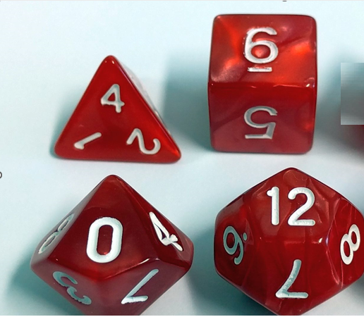
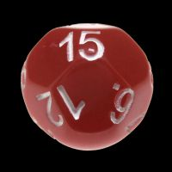
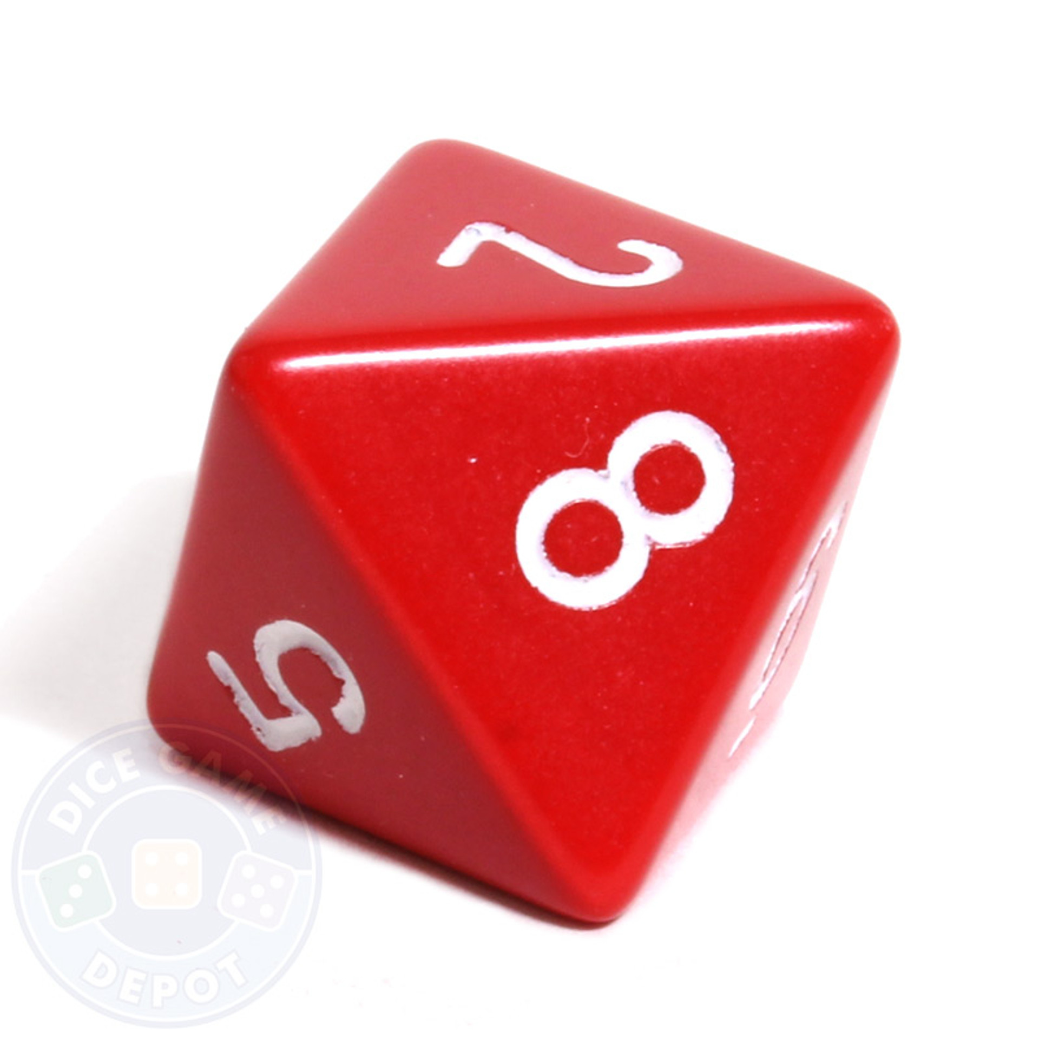
Game Scenario
D4
D6
CEO Sheet | Money | $Gained | $ADV | $DEV | $Prod.
Round1
Round2
Round3
Round4
Round5
Round6
Round7
Round8
Round9
Round10
The Game uses several dice: a d15, d12, d10, d8, d6, d4, and d3.
The game is won after x rounds, you decide how long to play. There are two winners, the CEO winner, and the player winner. The CEO winner is the CEO who has the most points, same for the player winner.
If you were playing a one-round game, with 4 people, you would have two CEOs and two players. CEO 1 might invest $550 in adv and $450 in production. CEO 2 might invest $550 in adv and $400 on dev. The player who chooses CEO 1’s game has two successful rolls, making $300. CEO 2’s player rolls one successful roll, making $350 and winning.
D10
D12
Player Sheet | Dice Points | Half Points | Total Points
Round1
Round2
Round3
Round4
Round5
Round6
Round7
Round8
Round9
Round10
D15
D8

Slide 4
Probability
Money spent on adv | Type of Dice
0 | D15
200 | D12
300 | D10
400 | D8
550 | D6
850 | D4
The two probability principles I used were basic probability (i.e., dice roll = 1/6) and expected value.
Basic probability is used for dice rolls.
Expected value is used money the amount of money a roll makes is taken into account.
Money Spent on Dev | Unit Profit | Time for Development
$0 | $150 | 1min
$150 | $215 | 1.25min
$250 | $275 | 1.5min
$400 | $350 | 2min
550 | $400 | 2min
Money spent on production | Amount of Chosen numbers (caps at 5)
0 | 2
300 | 3
450 | 4
700 | 5

Slide 5

Probability and Strategy
The tables from the previous slide show various dice types and amounts of numbers that affect the probability of you winning. These tables illustrate the ways in which strategy is used in Stonks. Not spending anything on advertising would give a very low chance of making anything. Still, there are better ways than dumping all your resources into one category.
A person might spend $550 on advertising and $450 on production. This would make your probability of scoring on a roll 4/6. While this seems great, there are better ways to do it. This is where the concept of expected value comes in. 4/6*150 = 100, but if we spent $400 on advertising, $450 on production, and $150 on development, we would get 4/8*215 = 107.5, and you would also get a bit more dev. time, making the second option a better choice.

Slide 6
Citations (MLA 9th Edition)
Farkle. Play Monster, 2016.
“IMPACT OPAQUE RED & WHITE D15 DICE.” DiceShop, https://www.thediceshoponline.com. Accessed 17 July 2023.
Lowe, S. Edwin. Yahtzee. Hasbro, 1956.
Roser, Christoph. “D4, D6, D8, D10, D12, and D20 Dice.” AllAboutLean.Com, 7 Dec. 2017, https://www.allaboutlean.com. Accessed 17 July 2023.
“8-Sided Opaque Dice (D8) - Red.” Dice Game Depot, https://www.dicegamedepot.com. Accessed 17 July 2023.
“Stonks.” YouTube, Grandayy, 18 June 2019, https://www.youtube.com/watch?v=if-2M3K1tqk.

